Slide 1
Athlete Media Appearance Scheduler
SlideMake.com

Slide 2
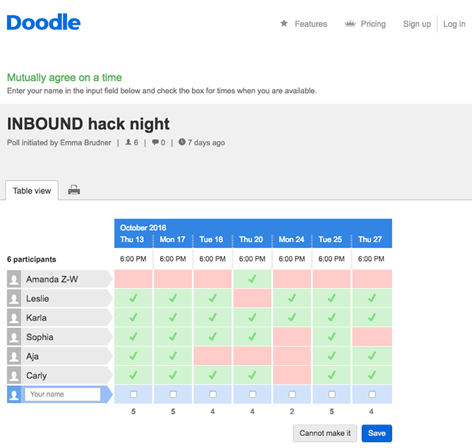
Introduction to Athlete Media Appearance Scheduler
The Athlete Media Appearance Scheduler is a tool designed to streamline and organize media engagements for athletes.
It helps athletes manage their time effectively while maintaining a professional presence in the media.
The scheduler is essential for maximizing media opportunities and enhancing an athlete's public image.
1
Notes:
Image source: https://blog.hubspot.com/marketing/meeting-scheduler-tools-more-productive

Slide 3

Importance of Media Engagement
Media appearances play a critical role in building an athlete's brand and visibility.
Effective media engagement can lead to sponsorship opportunities and increased fan interaction.
Athletes who manage their media appearances well often enjoy a more favorable public perception.
2
Notes:
Image source: https://kellyworrall.co.uk/social-media-engagement-2/

Slide 4
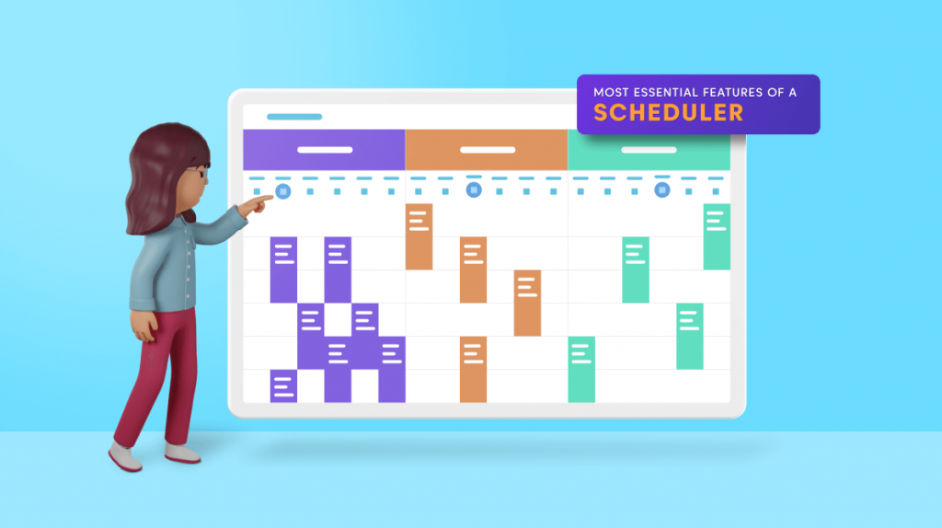
Key Features of the Scheduler
The scheduler includes a user-friendly interface that allows athletes to view and manage their media commitments easily.
It offers reminders and notifications to ensure athletes never miss an appearance.
The tool also provides analytics to assess the impact of media engagements on an athlete's brand.
3
Notes:
Image source: https://www.syncfusion.com/blogs/post/9-most-essential-features-of-a-scheduler.aspx

Slide 5
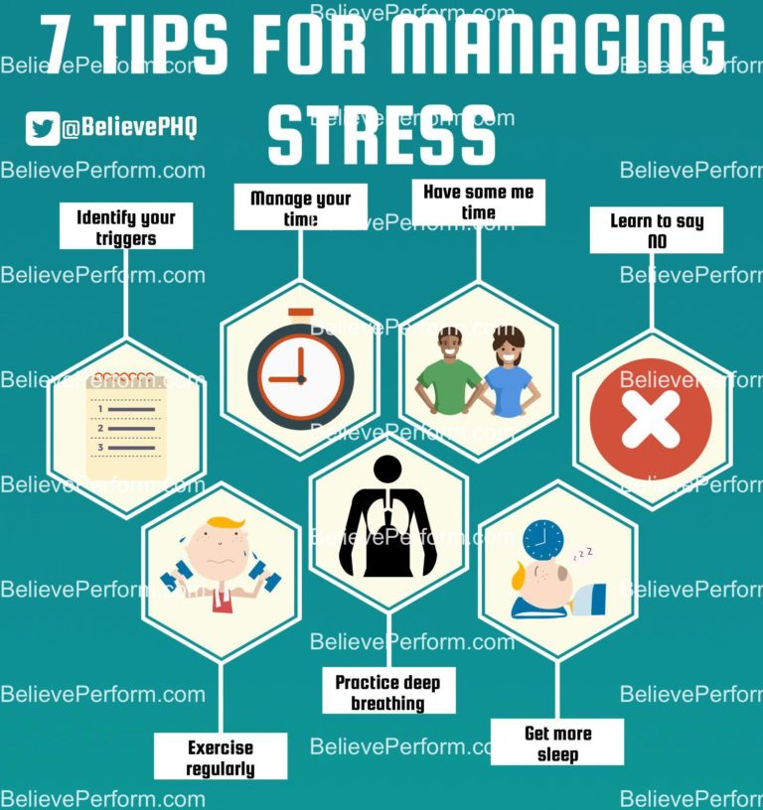
Benefits for Athletes
Athletes can save time and reduce stress by having a centralized platform for scheduling media appearances.
The scheduler enhances communication between athletes, their agents, and media outlets, fostering better relationships.
Athletes can focus on their training while the scheduler manages their media obligations.
4
Notes:
Image source: https://believeperform.com/product/7-tips-for-managing-stress/

Slide 6
Implementation Strategy
Implementing the Athlete Media Appearance Scheduler requires training for both athletes and their support teams.
A phased rollout can help identify and resolve any issues before full implementation.
Regular feedback from users is essential to improve the scheduling system continually.
5
Notes:
Image source: https://templates.rjuuc.edu.np/en/strategy-implementation-plan-template.html

Slide 7
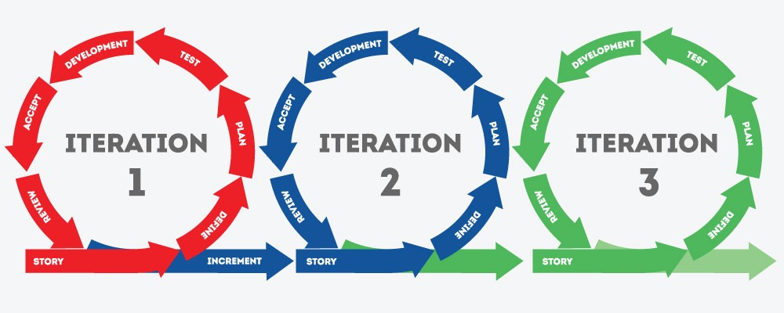
Future Enhancements
Future iterations of the scheduler may include AI-driven recommendations for optimal media engagement times.
Integration with social media platforms could provide real-time updates and engagement metrics.
Expanding the scheduler's capabilities to include virtual appearances will help adapt to the evolving media landscape.
6
Notes:
Image source: https://www.ntaskmanager.com/blog/agile-planning-drafting-and-executing-projects/

